Slide 1
Cross Departmental Accessibility Focus: College-Wide Student Success and Online Courses
Steven Bianco, Coordinator, Accessibility and LMS Administration
Dr. Rozalind Jester, Assistant Vice Provost, Online Learning

Slide 2
Key Points
Create a culture of collaboration and awareness training for compliance.
Identify campus stakeholders and develop strategic partnerships with Academic Affairs, Library, Information Technology, and ADAptive Services.
Inter-departmental collaboration to ensure students, faculty, and staff are directed to appropriate resources.

Slide 3
The Point of this Talk is to…
Establish connections in your institution for accessibility collaboration.

Slide 4
Why Care?
Making relationships and connections within your institution impact student success.

Slide 5
FSW’s Accessibility Journey

Slide 6
Create a Position
The job description at FSW focused on collaboration and training.
Training for FSW IT through Online Learning Consortium (OLC) workshops.
Fundamentals: ADA & Web Accessibility
Strategic Planning for Web Accessibility
Designing with Accessibility in Mind

Slide 7
Rekindling the Accessibility Working Committee
We developed a list of stakeholders for the revived committee and an action plan.
Designated the EIT position as chair of the Accessibility Committee.
Meetings are an open forum for discussion.

Slide 8
The Accessibility Working Committee
The committee meets every two months
30+ members
Members plan for both electronic and physical accessibility.
Benchmark Progress through the areas each meeting.

Slide 9
Office of Information Technology Example
Weekly Professional Development Session on accessibility topics through the Teaching and Learning Center.
Other formal workshops on accessibility tools like Blackboard Ally.
Universal Design and Access workshop as part of the DEV 101 course design certification process.

Slide 10
eLearning Example
Course reviews based on accommodations.
Notifying instructors about who to contact for questions.

Slide 11
Inter-Departmental Referrals
Through awareness training the point of contact information is available to faculty and staff.
Referrals are made between eLearning, Information Technology, ADAptive Services, and the Equity Office.

Slide 12
Building Relationships

Slide 13
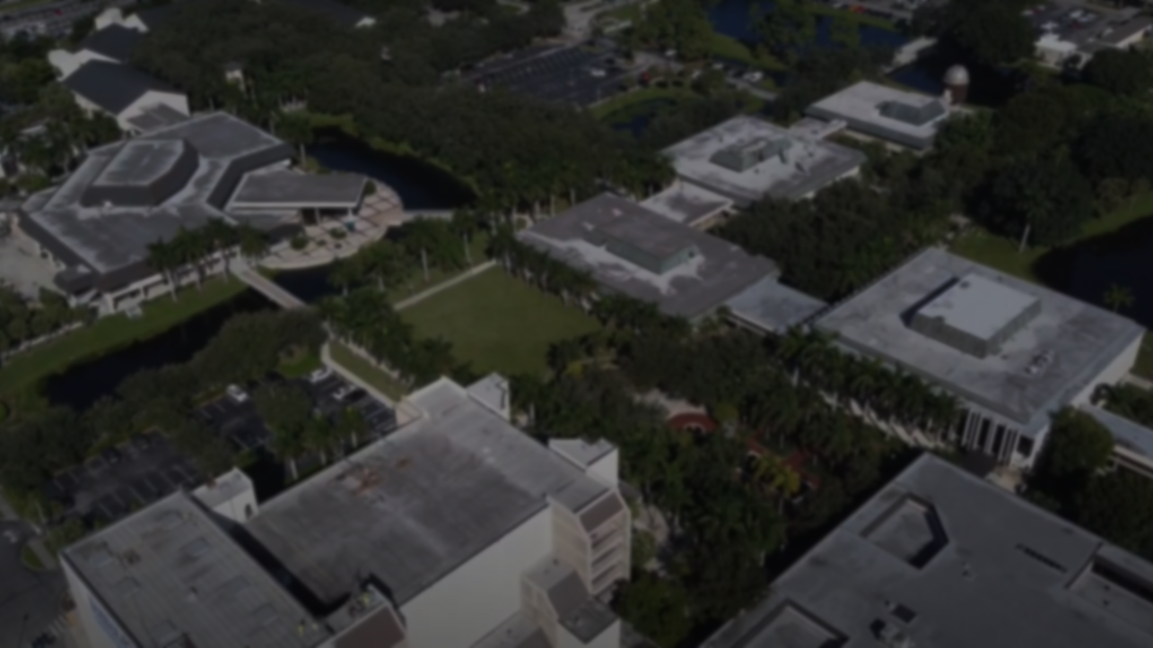
College-Wide Collaborations
Cabinet Level Support
Provost
Office of Information Technology
Instructional Design Team
Academic Affairs
Student Affairs
ADAptive Services
CIO
Electronic Information Technology (EIT) Accessibility
Technology Support Center
Equity Office
Online Learning
Teaching and Learning Center
Faculty Champions
Academic Administrators

Slide 14
The Data
DEV 101
Blackboard Ally
Institutional Goals

Slide 15
The Data – DEV 101
21% Average Improvement in course accessibility where the faculty developer completed DEV 101.
Based on Blackboard Ally Data.

Slide 16
The Data – DEV 101 Survey

Slide 17
The Data - Blackboard Ally

Slide 18
The Data - Institutional Goals
Among those adopting accessibility as a goal, the most popular were:
All [department] staff will attend accessibility training sessions on an accessibility topic of disability awareness and/or accessible document creation.
All [department] webpages will meet best practices of accessible design.

Slide 19
Questions?
20 Minutes, ask away!

Slide 20
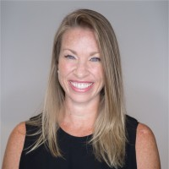
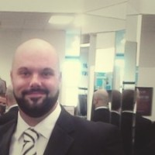
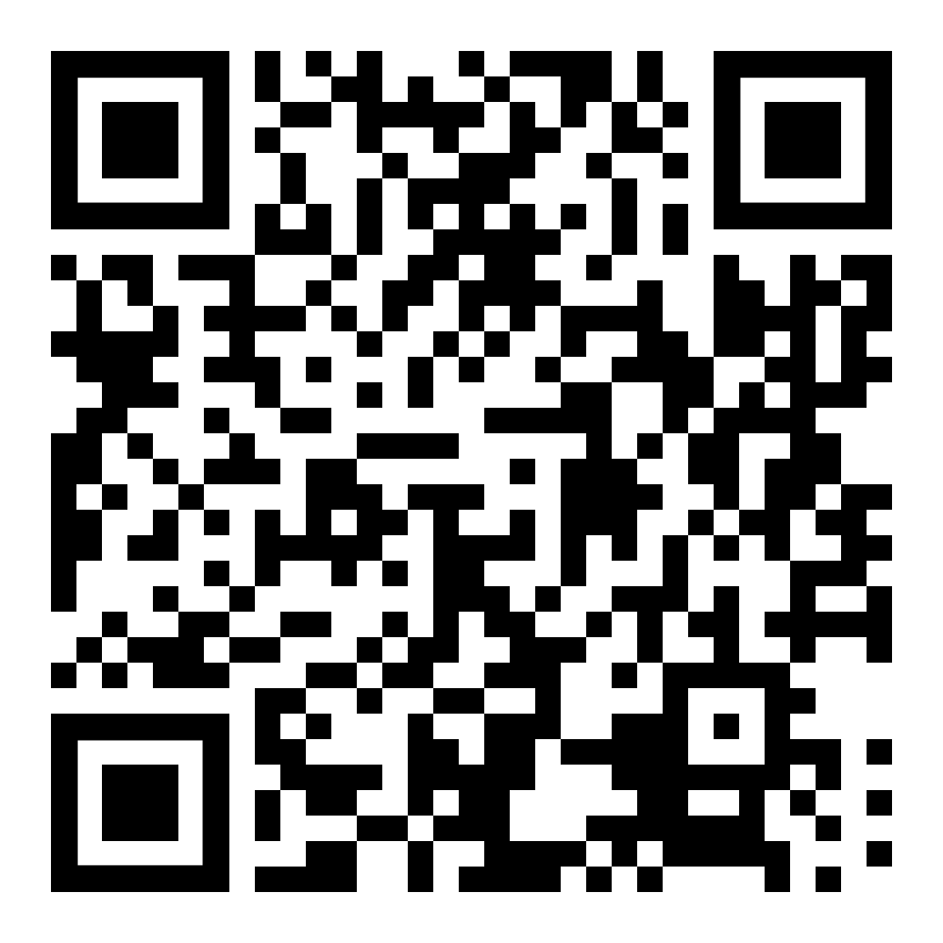
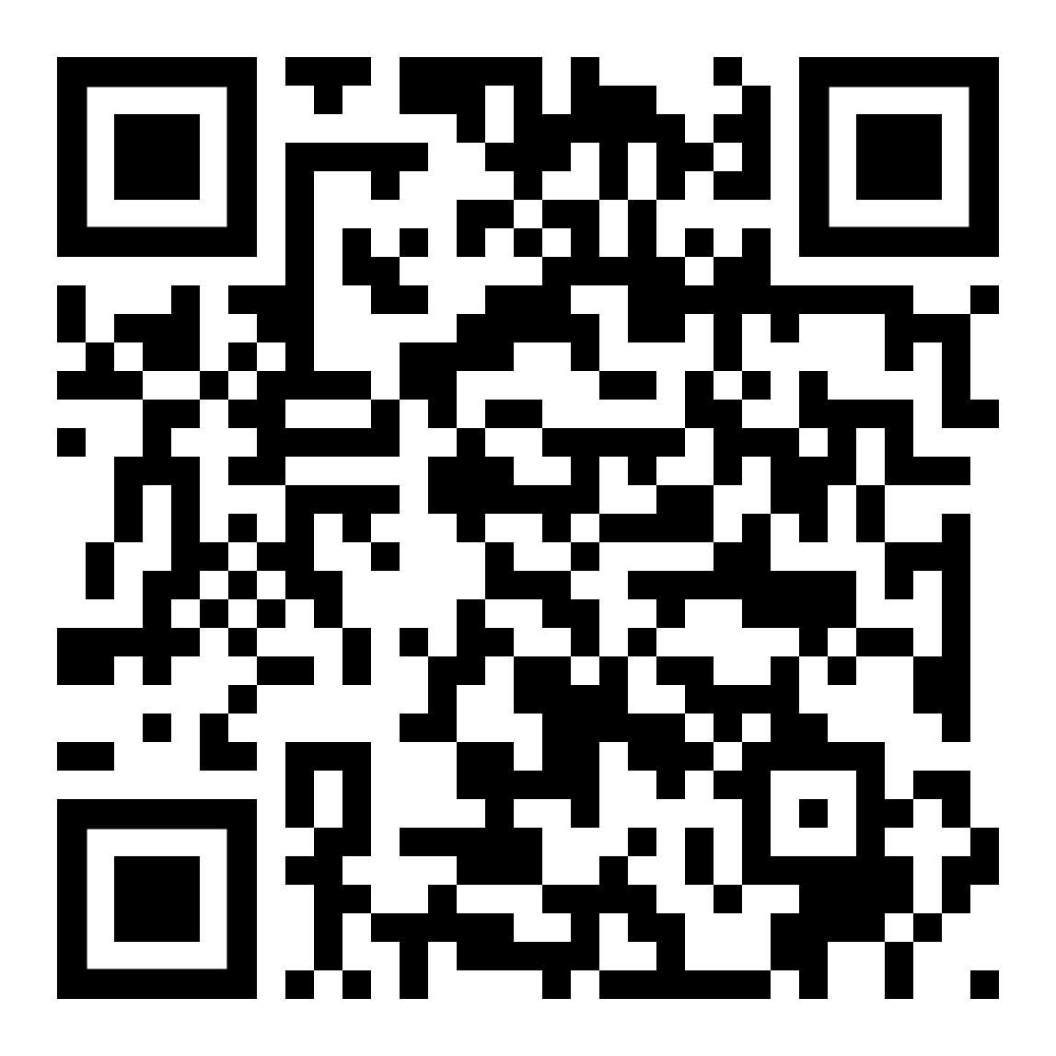
Thank You!
Steven Bianco (sbianco@fsw.edu)
Dr. Rozalind Jester (rjester@fsw.edu)

